Slide 1
Nacepin – A project by team MEDISALTON

Slide 2









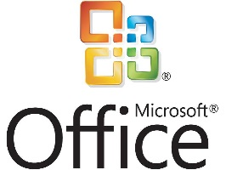

Software used
GitHub, HTML, CSS, JavaScript, JQuery, Maven, INTELIJ, WebStorm, XAMPP, Microsoft Office, Skype

Slide 3
Overall Coverage
Number of Positive Test Cases: 34
Number of Negative Test Cases: 26
Overall: 60 with 21 additional Iterations, covering approximately 80%
Number of Test Cases Automated: 11 approximately 10%
Number of Use Cases: 11 approximately 85-90%
Number of User Stories: 14 approximately 90-95%

Slide 4
SRS Coverage
1. Introduction
1.1 Purpose
1.2 Document Conventions
1.3 Intended Audience and Reading Suggestions
1.4 Product Scope
1.5 Business Goal
1.6 References Buyer Business Benefits
2. Overall Description
2.1 Product perspective
2.2 Product features
2.3 Product classes and characteristics
2.4 Operating environment
2.5 Design and implementation constraints
2.6 User documentations
2.7 Assumptions and dependencies
3. System Features
3.1 Secure login to interface
3.2 Secure registration form
4. External Interface Requirement
4.1 User Interface
5. Functional Requirement
5.1 Some actions do not require any registration
6. Other Nonfunctional Requirement
6.1 Performance Requirement
6.2 Safety Requirement
6.3 Security Requirement
7. Definitions
8. Privacy Requirement
9. Resources used for the creation of the document

Slide 5
Thank you !
Team MEDISALTON: Боян Кацарски, Георги Костадинов, Димитър Игнатов, Дона Парлева

